Slide 1


Chapter 14
Section 2
Were They + Biased?

Slide 2

How Do We Know If A Witness Is Reliable?
Was the witness PRESENT at the time of the crime?
Can the witness’ statements be CORROBORATED in some way?
Has the witness been HONEST and ACCURATE over time?
Does the witness possess a BIAS that might cause him or her to lie?
Notes:
We went through: -
1.)
Present
We verified that the gospel writers were present during the time period they claimed to write about.
-
2.)
corroborated
We saw internal and external corroboration(confirmations) of the claims the gospel writers made.
-
3.)honest and accurate
A study of the chain of custody demonstrated that the eyewitness records have been preserved over time so that we can be sure the text was not altered from the original.
-
4.) Now we assess whether the gospel accounts are reliable; did they have a bias that led them to lie? An ulterior motive

Slide 3
Bias: Tendency to think in a way that is usually not based on a reasoned judgment.
No one wants to be called “biased” -it suggests no one can believe what you say. We all have biases of some sort, so that mode of thought can sometimes be misleading.
We all make judgments
Notes:
2.) biased -
3.) - Ie.) Will the brakes on my car work today?
Ie.) a family member gives preference to their family over strangers
ie.) An accomplice for a crime does not tell the truth about the crime because it would implicate him
ie.) A student grading his own test would have a bias to make his grade look better, even at the cost of honesty/integrity
ie.) Biased towards bacon. Means you put bacon above other foods.

Slide 4



Objections Offered By Skeptics
The Gospels Were Written by Christians
The Death Narratives of The Apostles Were Written by Christians

Slide 5
Were Christian claims based on the bias of a religious expectation?
A lie about Jesus’ resurrection might fool those who weren’t there, but not people who were there and knew better
That’s why we looked into the early timing of the gospels

Slide 6

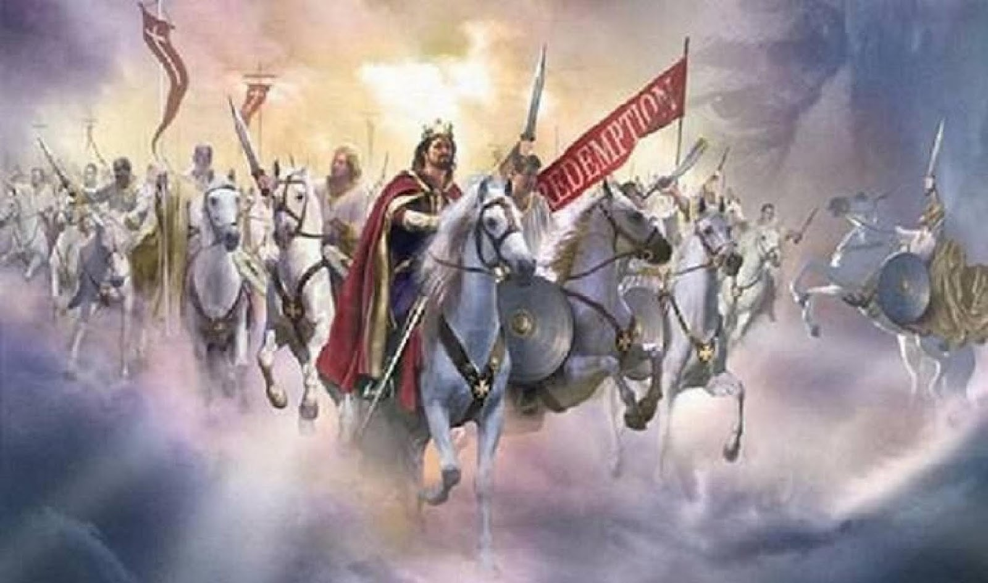
Bias Comparison
Bob – Police would never rob a bank
Sees one rob a bank
Do we disqualify his testimony because of bias? -------------------------------------------------------------------------------
Jews – Messiah a military savior
See Messiah prove Himself as a spiritual savior
Do we disqualify eyewitness accounts of Jesus because of bias toward a military savior expectation, and against the ‘suffering servant’ expectation?
Notes:
Let’s say we have a person, Bob who bias toward police officers in that he would never think one would rob a bank.
-The moment Bob were to witness a policeman robbing a bank, are we going to distrust Bob’s testimony that he witnesses a policeman robbing the bank?
-The fact that Bob had an opinion about the identity of the robber does not disqualify his ability to provide testimony of the robbery.
-Gospel authors were not “Christians” until the life and ministry of Jesus
-Jews in 1st century Palestine were looking for physical, conquering king, not a spiritual savior.
-these 2 examples of biases are folks who are testifying to the opposite of their bias expectation happening. Both are valid testimonies.

Slide 7
But the New Testament is written by Christians
Objection: Therefore we cannot trust it.
More important question: Why were they converted?

Slide 8
Let’s follow that line of reasoning
Does that mean you won’t read an atheist book because they are biased toward atheism?
Most authors believe what they are writing.
Most authors have an objective/goal for their book
A doctor can still be objective toward a patient even though he might have strong feelings toward a patient.
In fact, he might be more diligent with the diagnosing and treatment.

Slide 9
Did They Benefit Personally?
Why would the Jews who converted to Christianity risk persecution, death , and perhaps eternal damnation to start something that
1.)wasn't true
2.)elevated non-Jews into the exclusive relationship they claimed to have with the Creator of the Universe
Unless the resurrection actually happened, why would they, almost immediately, stop observing the Sabbath, the Law of Moses, temple worship, and other Old Testament teachings?
Jews couldn’t get any more special than being “God’s chosen people”
These New Testament writers decided to change over 2000 years of behavior that their ancestors had. Why?

Slide 10




What Three Motives Cause People To Lie?
Financial Greed
Sexual or Relational Lust
The Pursuit of Power
Notes:
Any motives/reasons to lie? These are the 3 things that motivate people to lie or harm others.
-
”lack of motive” is a frequent way that defense attorneys make a case for their client’s innocence. The “Why” someone did something is important.

Slide 11
Were the Apostles Motivated by Financial Greed?
“I do not possess silver and gold, but what I do have I give to you: In the name of Jesus Christ the Nazarene - walk!” (Acts 3:6)
“Did not God choose the poor of this world to be rich in faith and heirs of the kingdom which He promised to those who love Him?” (James 2:5).

Slide 12
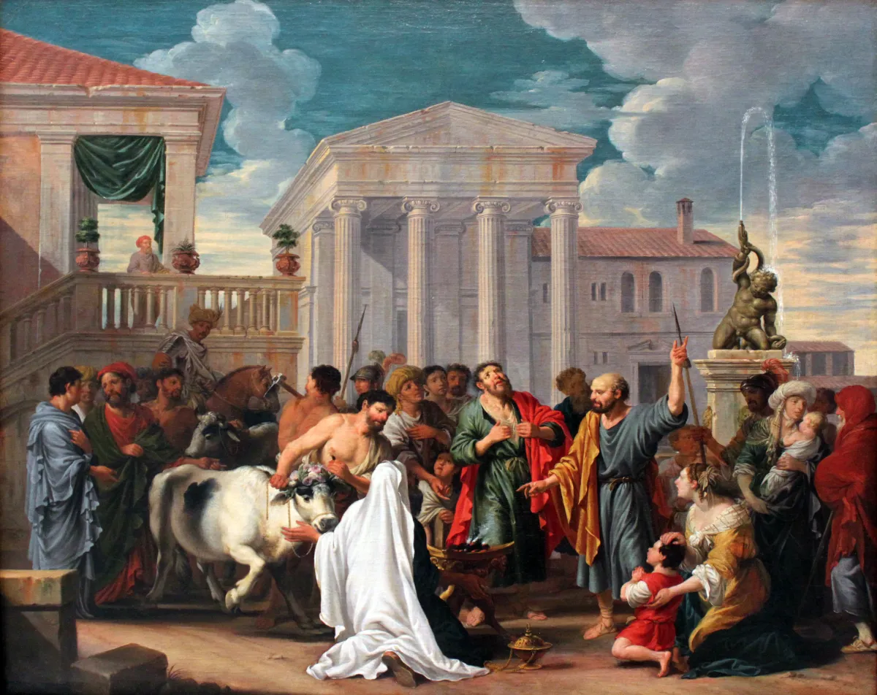
Or what about when a Greek city wanted to worship Paul and Barnabas?
They would have been set for life. Instead, they told the people to worship God.
Notes:
Ancient accounts of both secular and non secular nature wrote about the activities of the apostles. None describe the apostles as men of material wealth.

Slide 13
Financial gain?
Luke 18:29 – “Behold, we left our own homes and followed You”
1 Cor 4:11 – Paul said apostles were “both hungry and thirsty”, “poorly clothed”, “roughly treated”, and “homeless”
Acts 20:33 – observers of Paul said he “coveted no one’s liver or gold or clothes”
Acts 3:6 – paraphrase – we have no money, but in the name of Jesus, walk! (said to a lame man)

Slide 14
Paul’s letter were written early enough to people who knew Paul personally who would know if Paul was lying about his financial situation

Slide 15
Were the Apostles Motivated by Sexual or Relational Lust?
Clement of Alexandria Said This About Paul:
“The only reason why he did not take her about with him was that it would have been an inconvenience for his ministry.… [The apostles], in accordance with their particular ministry, devoted themselves to preaching without any distraction, and took their wives with them not as women with whom they had marriage relations, but as sisters, that they might be their fellow-ministers in dealing with housewives.”

Slide 16
Matt 8:14 – Peter had a wife and mother-in-law
1 Cor 9:5 – Paul claimed Peter was not the only married apostle
Clement(Alexandria) wrote that Peter and Philip had children
1 Tim 3:2 – apostles told men to only have 1 wife where multiple were ‘accepted’ by society
Simply no records indicating relational motivators to lie
Notes:
While it is true that there have been church leaders who have used their ministry as a means to take advantage of others in relationships, we see no evidence of that with the apostles.
-
Someone can make claims about the gospel authors, but we must ask ourselves if the claims are evidentially reasonable instead of only focusing on what is possible.

Slide 17
Motive to Lie – power?
Skeptics often think of the Roman Catholic leadership when Christianity became the state sponsored religion
1st century apostles had no such resemblance of power
Apostles met with extreme persecution which was more of a liability/cost than a materially useful asset
Notes:
Nonbiblical histories and writings of the apostles show that all but John were martyred for their testimony. If power were the motive for the testimony about the risen Jesus, then the apostles would have simply recanted if in fact it was a lie and they were alive to know it was a lie.

Slide 18
Were the Apostles Motivated by the Pursuit of Power?
Paul Said This About His Own Life:
Five times I received from the Jews thirty-nine lashes. Three times I was beaten with rods, once I was stoned, three times I was shipwrecked, a night and a day I have spent in the deep. I have been on frequent journeys, in dangers from rivers, dangers from robbers, dangers from my countrymen, dangers from the Gentiles, dangers in the city, dangers in the wilderness, dangers on the sea, dangers among false brethren; I have been in labor and hardship, through many sleepless nights, in hunger and thirst, often without food, in cold and exposure. Apart from such external things, there is the daily pressure upon me of concern for all the churches. (2 Cor. 11:24–28)

Slide 19
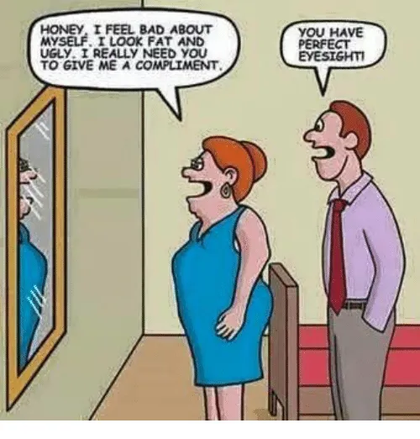
Motive to Lie - Self Embarrassment???
People lie to make themselves look better
But nobody lies to make themselves look bad

Slide 20
Self-Embarrassment Examples
Eyewitness main characters are: -dim-witted – don’t understand what Jesus says -uncaring – fell asleep on Jesus -didn’t bury Jesus – left it to Jesus’ enemies -Peter called “Satan” by Jesus -Peter rebuked by Paul for hypocrisy -Peter denies Jesus 3 times -are cowards – all but one stays for crucifixion -they doubted the resurrection
All are details you don’t add when making up a story
Notes:
------------------------------------------------------------------------ Pg 276. “I don’t have enough faith to be an atheist”

Slide 21
Embarrassing Jesus details
Considered “out of his mind” by his family
Not believed by his own brothers (John 7:5)
Called a “deceiver” (John 7:12)
Deserted by many of his followers (John 6:66)
Some “Jews who had believed in him” (John 8:30-31) wanted to stone Him (v. 59)
Called a “Drunkard” (Matt 11:19)
Called “demon-possessed” (Mark 3:22;John 7:20, 8:48)
Called a “madman” (John 10:20)
Notes:
-has His feet wiped with the hair of a prostitute, which could have been perceived as a sexual advance (Luke 7:36-39)
-crucified by the Jews and Romans, despite the fact that “anyone who is hung on a tree is under God’s curse” (Deut. 21:23, Gal 3:13)
These details are counter intuitive to folks who would make up a story about a perfect, sinless, God-man.

Slide 22
Difficult sayings of Jesus
“I tell you the truth, unless you eat the flesh of the Son of Man and drink His blood, you have no life in you” (John 6:53)
“from this time many of his disciples turned back and no longer followed Him” (John 6:66)
Who would invent a perfect, God-man Jesus who had followers, but said something that seemed so bizarre that His followers started leaving Him?
Notes:
This lesson is asking if there were motives for the gospel writers to lie.
Was their any gain they got out of writing these embarrassing moments and difficult sayings that Jesus said?
They are too counter-productive to be a lie.

Slide 23
Demanding Statements of Jesus
What motive would the gospel writers have to make Jesus say so many demanding things that no one had ever demanded so explicitly of people before?
Jesus says that looking at a woman lustfully makes you an adulterer at heart (Matt 5:28)
Divorce, except for infidelity, is adultery if you remarry (Matt 5:32)
Turn the other cheek and go the extra mile (Matt 5)
Love enemies and pray for your persecutors (Matt 5:44-45)
Be perfect as your Father is perfect (Matt 5:48)
Notes:
All these demands go against the very core of what most humans want to do.
-
Why would the gospel writers include these demanding statements about Jesus if He didn’t say them?
-
Where would they get ideas like what Jesus spoke about?
-
Why would they make up so many difficult sayings which would no doubt make less people want to convert to Christianity?

Slide 24
Motive to Make up these resurrection details?
Burial of Jesus – Joseph of Arimathea was a member of the Sanhedrin who sentenced Jesus to death
All 4 gospels say women were 1st witnesses of empty tomb. One was formerly demon-possessed. (witness liability?)
The risen Jesus did not appear to the priests, yet “a large number of priests became obedient to the faith” (Acts 6:7) -Acts 15:5 shows these priests later telling the Jerusalem council they must obey the law of Moses
Notes:
3.)If Luke had lied about priests converting to Christianity, his bluff could have been called out and his historical credibility diminished.

Slide 25
4 synoptic gospels big on history. Little on theology
They read more like historical accounts than theology (though it’s in there)
No mention of “believe in Jesus and you will resurrect like Him too” after mention of Jesus’ resurrection in the gospels
If making up a Jesus resurrection story and getting folks on-board, the gospel writers did a bad job at it. They didn’t even attempt to explain what the implications were of the resurrection (except John 20:31).
What motivation for that unless they were writing less to err on the side of accuracy

Slide 26
Claim: Maybe all those “chain of custody” early church father people colluded together to say that Jesus was resurrected so that they could get power and control over people
Conspiracies hard to maintain with so many participants and so much time. Early church leaders were also often met with frequent persecution, which aren’t exactly perks...
Notes:
1.)which is a conclusion against the evidence

Slide 27

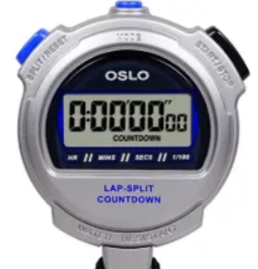


Successful Conspiracies - Summary
Small number of conspirators
Thorough and immediate communication
Short time span
Significant relational connections
Little or no pressure
Notes:
1.)The larger the number of co-conspirators, the more likely you will have someone telling the truth so that the conspiracy fails.
2.)When co-conspirators are unable to determine if their partners in crime have told the truth, they are very likely to fess up to their crimes to save their own hide. We see that kind of behavior in movies all the time.
3.)Lies are often hard to tell once, but a lot harder to tell over a long period of time without inconsistencies boiling up.
4.)With conspiracies, the greater the bond (ie. family) between the conspirators, the higher chance they will pull off a conspiracy without one person ratting out the other.
5.)The greater that pressure on co-conspirators, the less likely they will keep their mouths shut to save themselves from punishment.
In other words, the more co-conspirators realize they are in trouble and how much it will cost for not telling the truth, the more likely they will spill the beans.

Slide 28
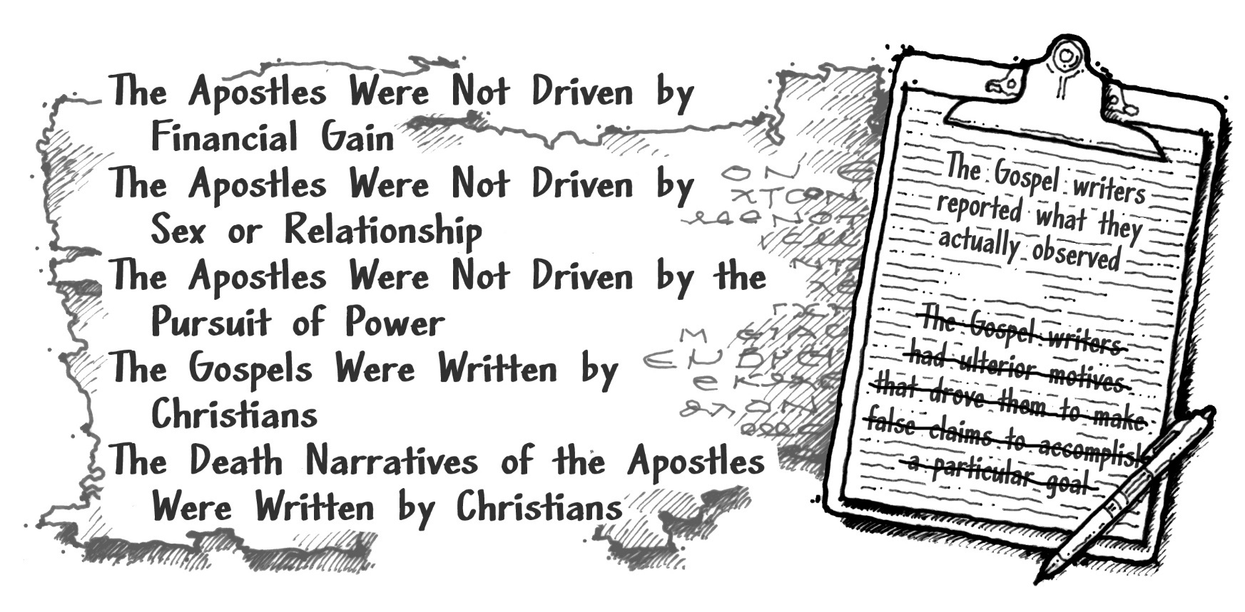
The Gospels Pass the Fourth Test

Slide 29
Apostles
Lacked motive for earthly gain
Not possible to benefit materially
Were concerned about eternal life
No motive for telling lies for spiritual claims they knew were untrue
Most reasonable explanation: They were telling the truth.

Slide 30
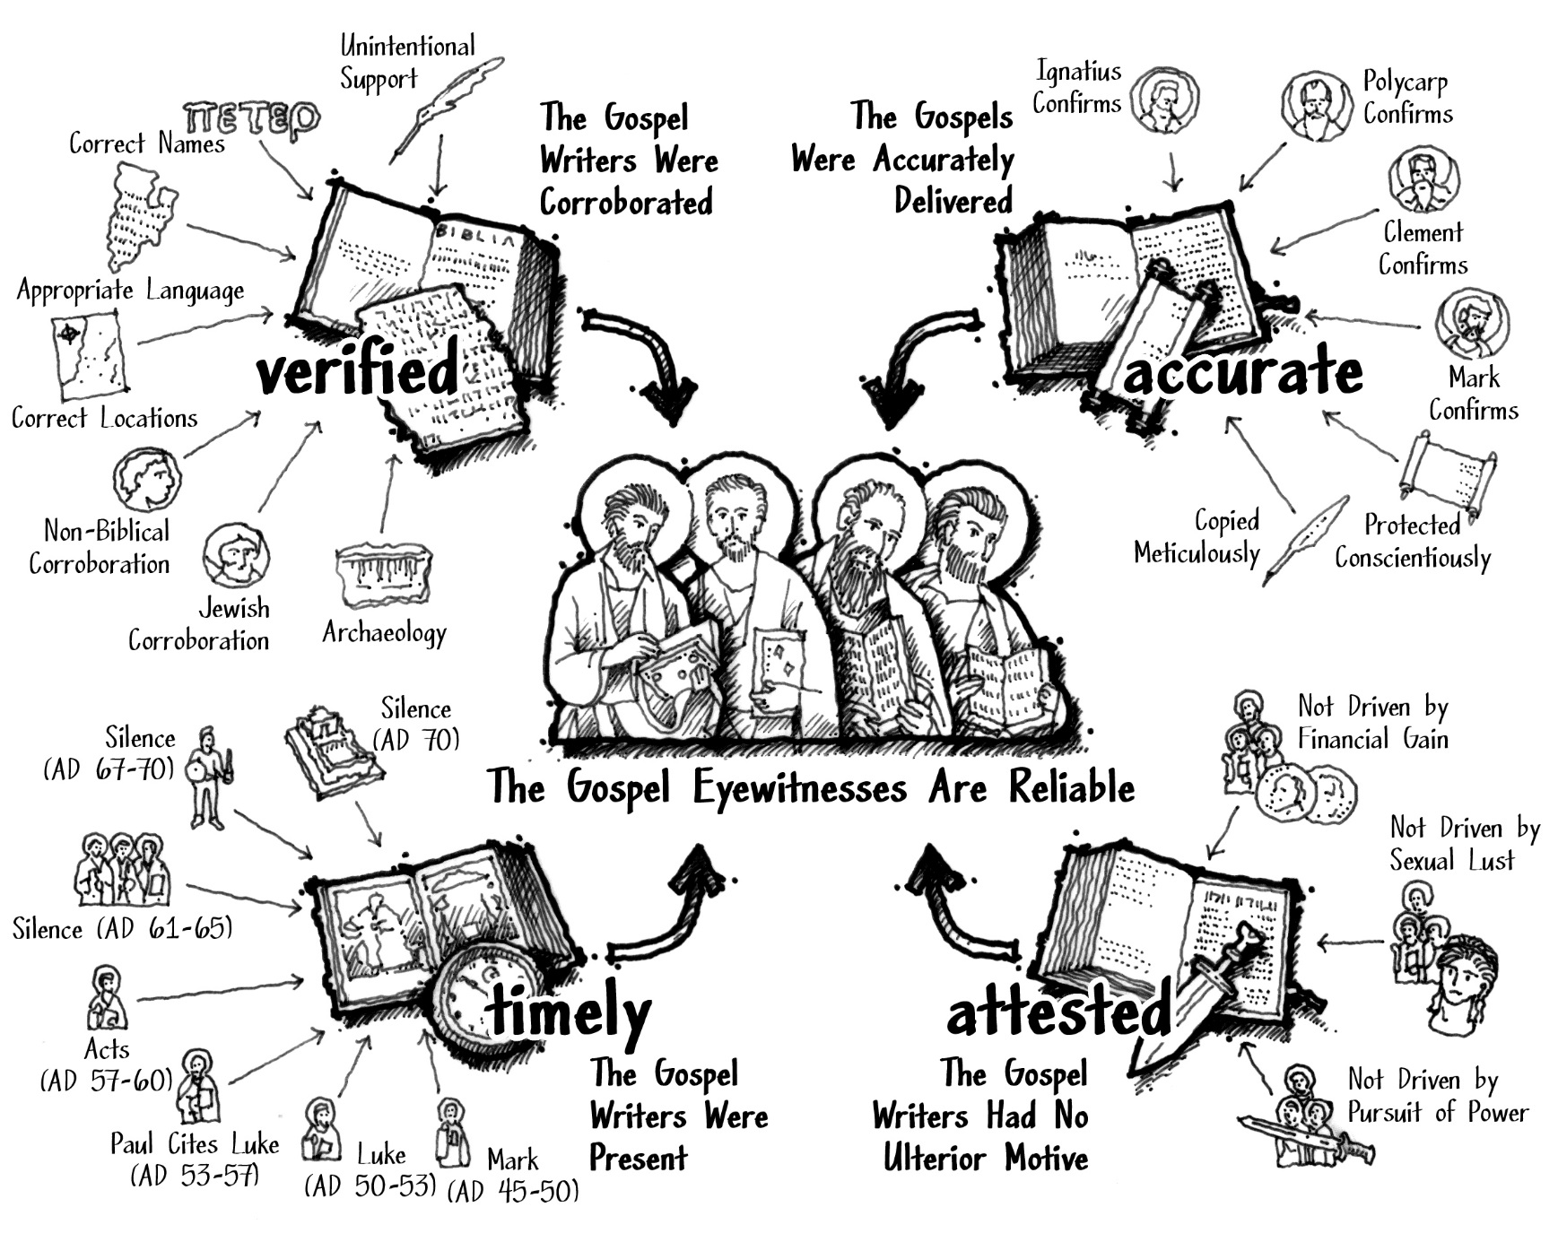
Notes:
The most reasonable inference from the evidence is that the gospel writer accounts were present, corroborated, accurate, and unbiased in that they had no motivating reason to lie. We can now conclude, based on the evidence, that the gospel accounts are reliable eyewitness testimony.

Slide 31
for more information visit:
www.ColdCaseChristianity.com

